Slide 1
TEAM 4
LEARNING CURVE

Slide 2
THE ISSUE AT HAND
PEN AND PAPER BASED
TIME TAKING
LABORIOUS
Data Management
Manual Search
DATA COLLECTION
Generating Analysis Reports

Slide 3


SOLUTION
Data pertaining to various students is recorded in an EXCEL sheet
Consolidated data
Uploaded to database

Slide 4

Consolidated data
Online form
Uploaded to database

Slide 5



SOLUTION

Slide 6
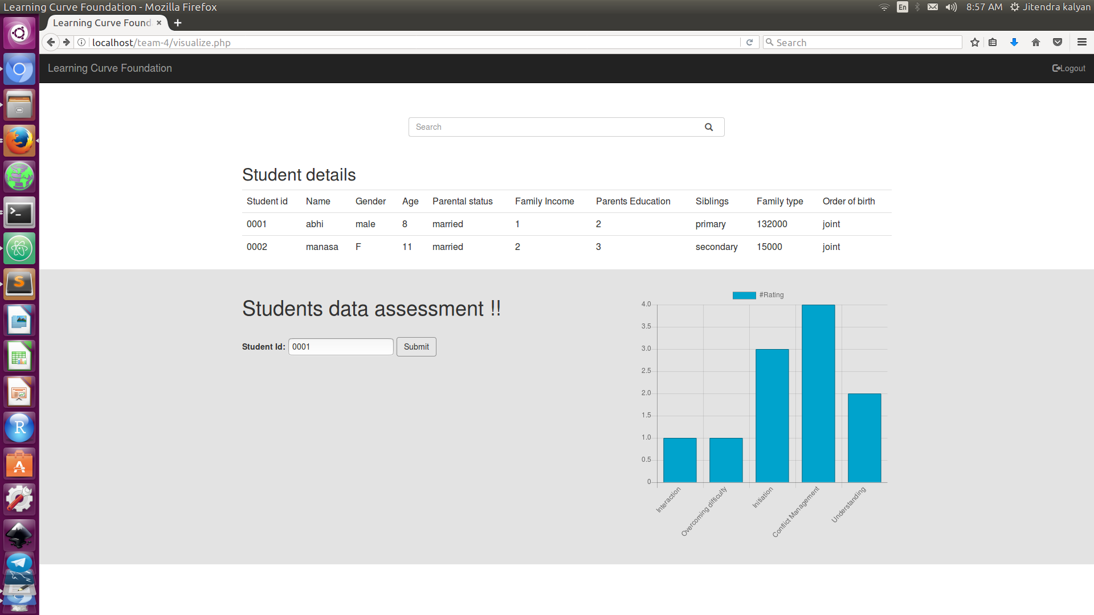
SOLUTION

Slide 7
FUTURE ENHANCEMENTS
Make It Available Offline.
Using Cloud

Slide 8
CHALLENGES
PULLING UP AN ALL NIGHTER!
INTEGRATION
STRUCTURING
COLLABORATION TOOLS

Slide 9


